Slide 1
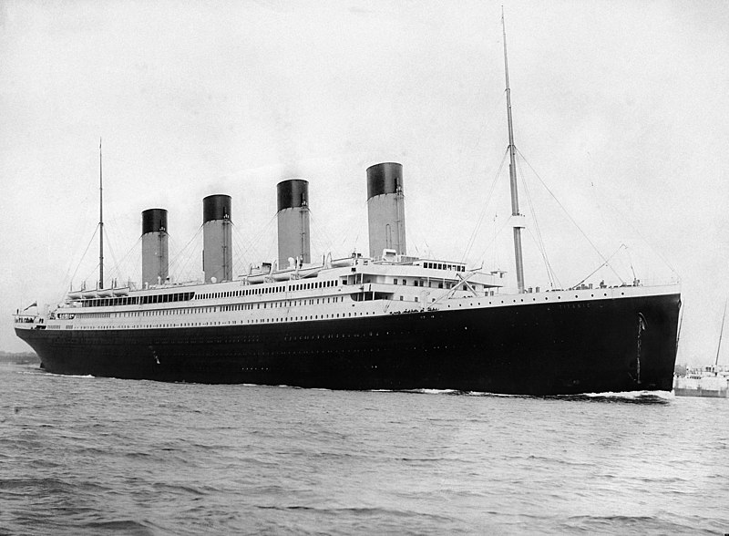

Titanic - Machine Learning from Disaster
sinking the ‘unsinkable’
by: Dionixius
Data Science Digital Skill Fair 30.0
by:

Slide 2





TABLE OF CONTENTS
About Me
Data Modeling - Evaluation
Business Modeling
Conclusion
Data Scrapping - EDA
Data Science Digital Skill Fair 30.0
by:

Slide 3









About Me
As a fresh graduate in Mathematics from Universitas Negeri Malang, I am an alumnus of Bangkit Academy by Google, GoTo, and Traveloka 2023. I have honed my skills as a Machine Learning Programmer in a Google-incubated team and am currently a Research Assistant in the Mathematics Department of FMIPA, Universitas Negeri Malang. My expertise lies in data and AI/ML, where I have a passion for transforming abstract data into actionable insights that benefit both myself and others. I am actively seeking opportunities in data analysis, data science, machine learning engineering, and other STEM-related fields.
https://www.linkedin.com/in/dionixius/
inikampus7@gmail.com
Tools in this project
Data Science Digital Skill Fair 30.0
by:

Slide 4
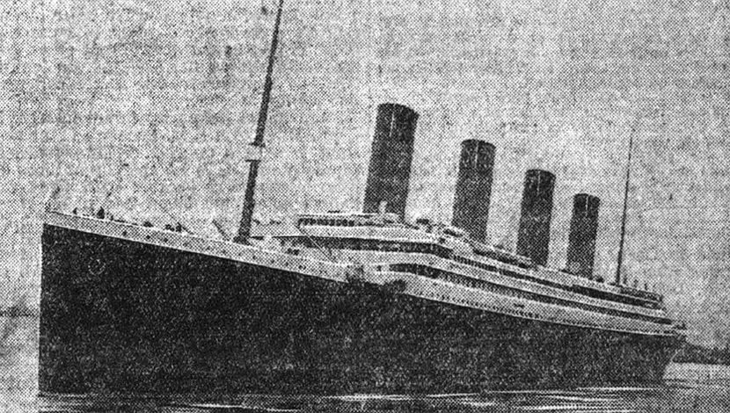
BUSINESS MODELING
Which gender of passengers was more likely to survive the tragedy?
Did the situation of bringing many family members affect the ability to survive in this tragedy?
Within the Titanic, there were several classes. Which class had a high probability of survival?
In this tragedy, what age range was more likely to survive?
Of the three types of algorithms to be formed, which algorithm is best for this Titanic dataset?
"There is no danger that Titanic will sink.
The boat is unsinkable, and nothing but inconvenience will be suffered by the passengers."
~ Philip Albright Small Franklin
Data Science Digital Skill Fair 30.0
by:

Slide 5













Roadmap Data Extraction
Data Modeling
The data will be trained using three machine learning algorithms: neural networks, support vector machines (SVM), and k-nearest neighbors (KNN).
4
3
Data Scrapping
The Titanic disaster dataset was sourced from Kaggle: https://www.kaggle.com/competitions/titanic
Data Evaluation
Model performance will be evaluated based on accuracy, classification report, and confusion matrix.
1
2
EDA + Feature Engineering
The dataset will be subjected to in-depth analysis to extract meaningful insights and identify potential modifications for optimal model training.

Slide 6
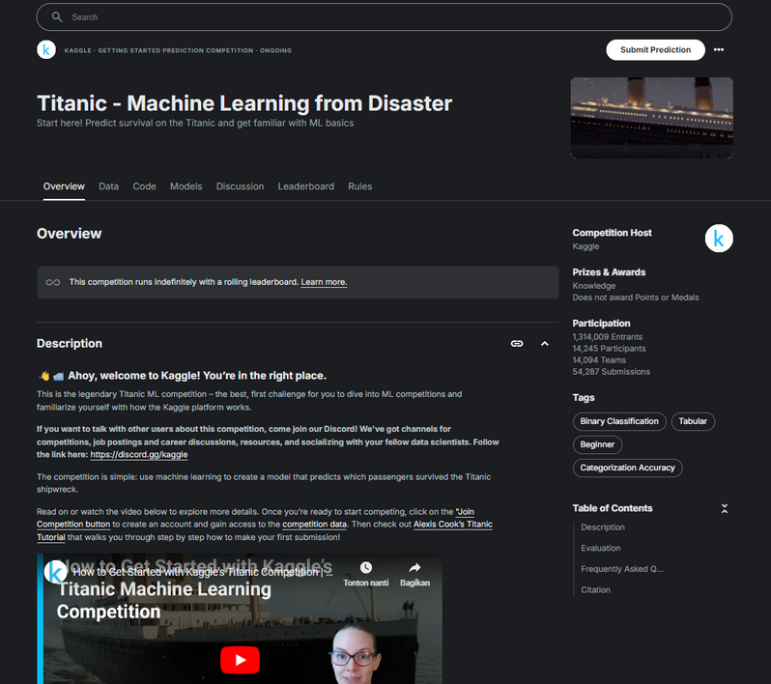
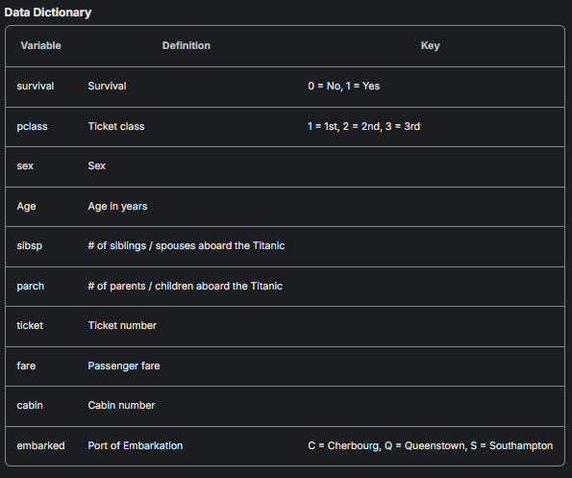
DATA SCRAPPING - EDA + FEATURE ENGINEERING
Objective:
The primary objective of this analysis is to identify the key factors influencing passenger survival rates during the Titanic disaster. By comparing the performance of various machine learning algorithms, we aim to develop a predictive model that can accurately classify passengers as survivors or casualties.
https://www.kaggle.com/competitions/titanic/data
Data Science Digital Skill Fair 30.0
by:
Data dictionary

Slide 7
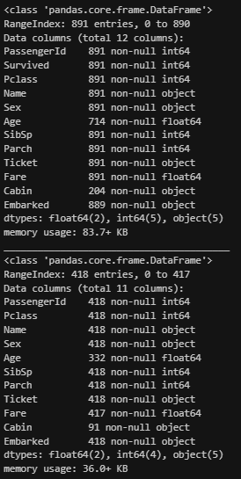
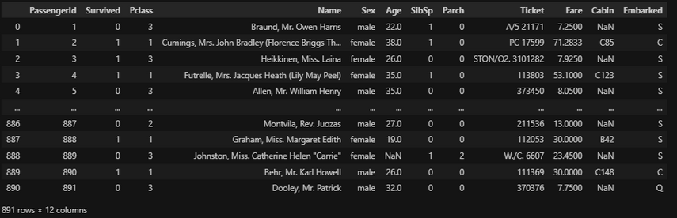
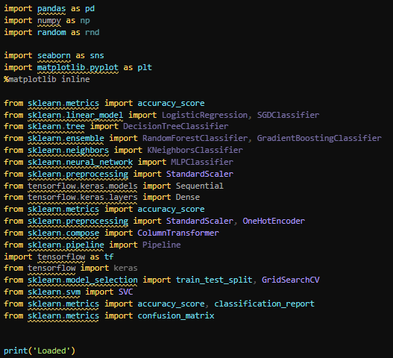
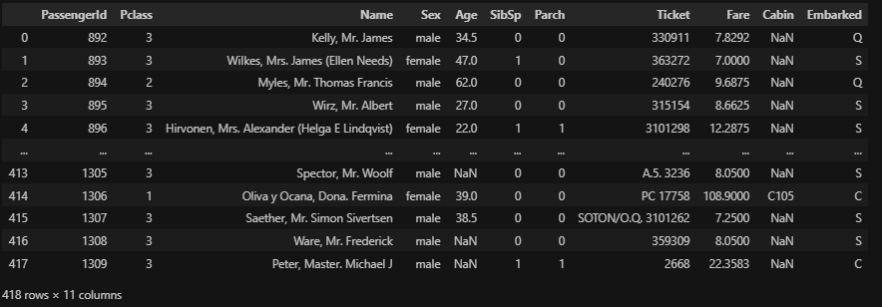
DATA SCRAPPING - EDA + FEATURE ENGINEERING
Train data
Test data
Libraries used
Data Science Digital Skill Fair 30.0
by:

Slide 8
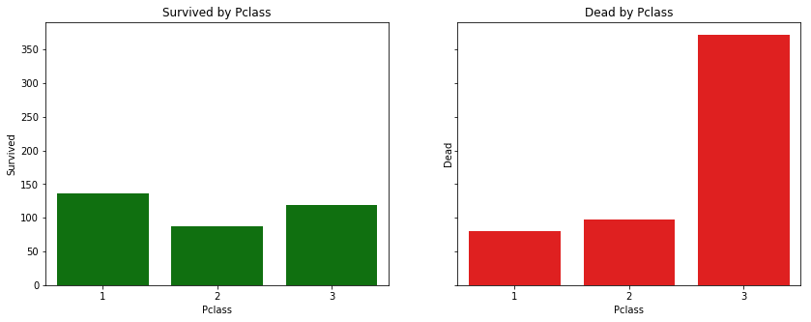
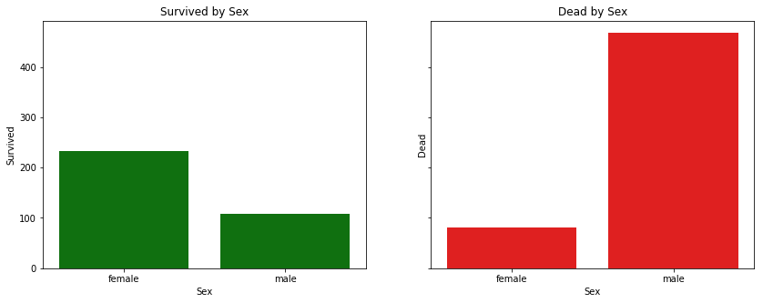
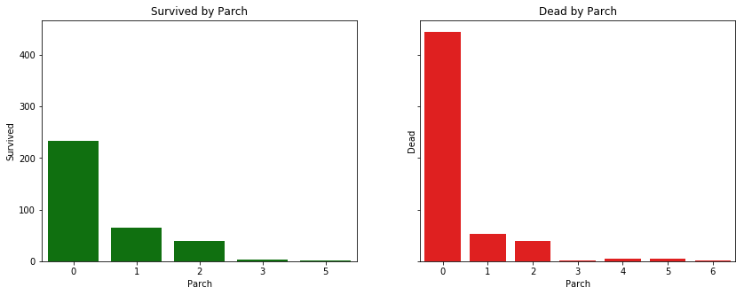
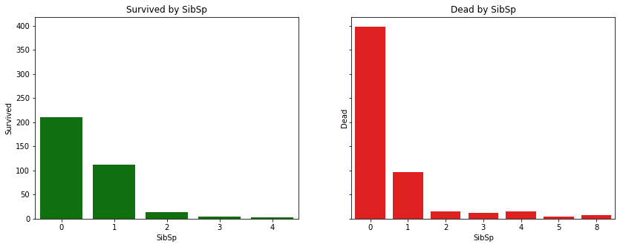
DATA SCRAPPING - EDA + FEATURE ENGINEERING
EDA (Exploratory Data Analysis)
First-class passengers had the highest survival rate, while third-class passengers had the highest fatality rate
Women had a significantly higher survival rate compared to men
Passengers traveling alone had the highest fatality rate, while those traveling with two or more parents or children had the highest survival rate
Passengers traveling alone had both the highest survival and fatality rates
Data Science Digital Skill Fair 30.0
by:

Slide 9
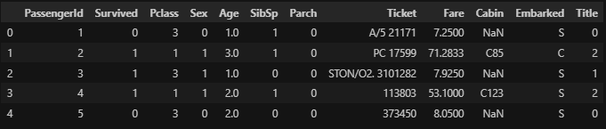
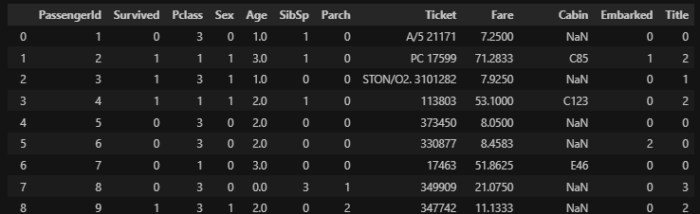
DATA SCRAPPING - EDA + FEATURE ENGINEERING
Feature Engineering
The purpose of feature engineering is to enhance the performance of machine learning models by creating, selecting, or transforming features (variables) used in model training
To enhance the model's performance, the age column was transformed using the code below:
0 for individuals 16 years old or younger,
1 for those aged 17 to 26,
2 for 27 to 36,
3 for 37 to 62, and
4 for those over 62.
To enhance the model's performance, the embarked column was transformed using the code below:
0 for S
1 for C
2 for Q
Data Science Digital Skill Fair 30.0
by:

Slide 10
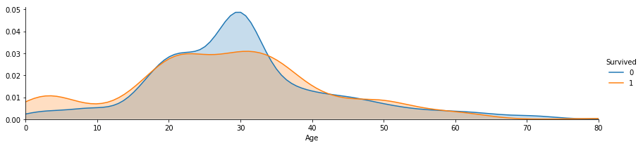
DATA SCRAPPING - EDA + FEATURE ENGINEERING
Feature Engineering
The graph shows the age distribution of Titanic passengers who survived and those who perished. It is evident that the 20-30 age group experienced the highest mortality and survival rates.
Data Science Digital Skill Fair 30.0
by:

Slide 11
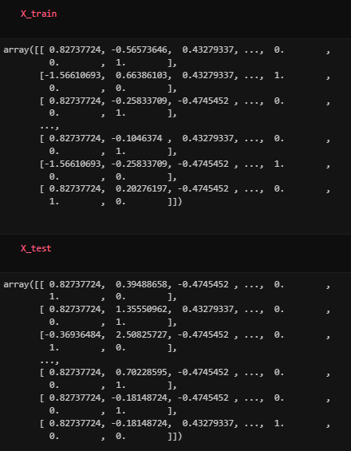
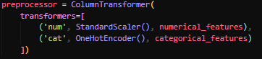
DATA MODELING - EVALUATION
Data Modeling
Next, the code categorizes features into numerical and categorical types. Numerical features are standardized using StandardScaler, while categorical features are one-hot encoded using OneHotEncoder. This preprocessing step is essential for ensuring that the data is in a suitable format for machine learning algorithms.
Data Science Digital Skill Fair 30.0
by:

Slide 12

DATA MODELING - EVALUATION
Model used
Support Vector Machine
Neural Network
KNN Classifier
Data Science Digital Skill Fair 30.0
by:

Slide 13
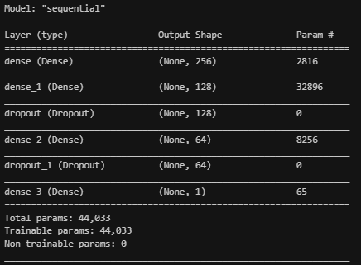
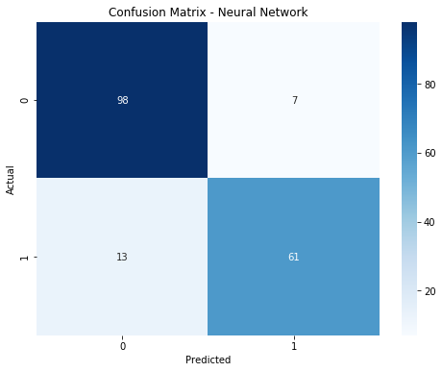
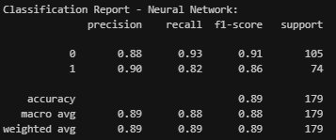
DATA MODELING - EVALUATION
Neural Network
train_test_split = 0.2
Neural Network
Sequential Layer (Best Model)
Confusion Matrix
Classification Report
Data Science Digital Skill Fair 30.0
by:

Slide 14
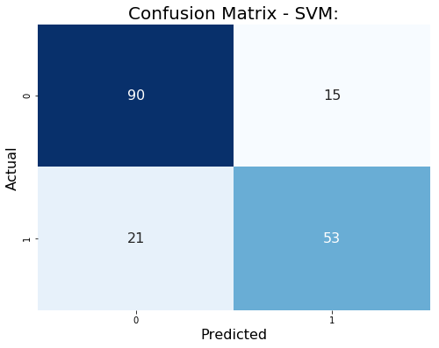
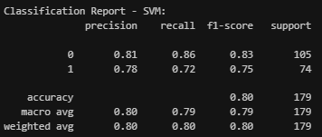
DATA MODELING - EVALUATION
Support Vector Machine (SVM)
train_test_split = 0.2
Best parameters for SVM:
{'C': 10, 'gamma': 0.1, 'kernel': 'poly'}
Support Vector Machine
Data Science Digital Skill Fair 30.0
by:

Slide 15
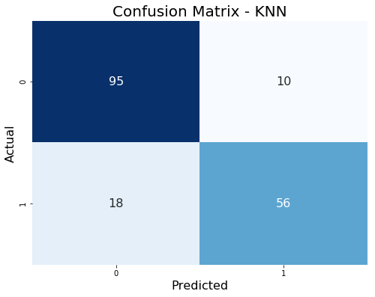
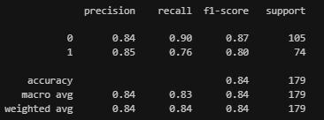
DATA MODELING - EVALUATION
KNN Classifier
train_test_split = 0.2
KNN Classifier
Best parameters for KNN:
{'metric': 'manhattan', 'n_neighbors': 12, 'weights': 'uniform'}
Data Science Digital Skill Fair 30.0
by:

Slide 16
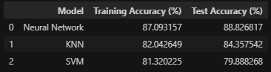
CONCLUSION
Questions
Answer
Which gender of passengers was more likely to survive the tragedy?
Did the situation of bringing many family members affect the ability to survive in this tragedy?
Within the Titanic, there were several classes. Which class had a high probability of survival?
In this tragedy, what age range was more likely to survive?
Of the three types of algorithms to be formed, which algorithm is best for this Titanic dataset?
Female passengers had a higher probability of survival than male passengers.
Yes, it had an effect. Based on the data provided, the condition of not being with family/relatives could increase the chances of survival.
Class 1.
It was found that the age range of 20-30 was more likely to survive, but in that range, many also died.
Of the three types of algorithms, namely neural networks, SVM, and KNN classifier, the following results were obtained:
a. Neural Network: 88.82%
b. KNN Classifier: 84.35%
c. SVM: 79.88%
The neural network algorithm has a higher accuracy capability compared to the other two algorithms.
Data Science Digital Skill Fair 30.0
by:

Slide 17
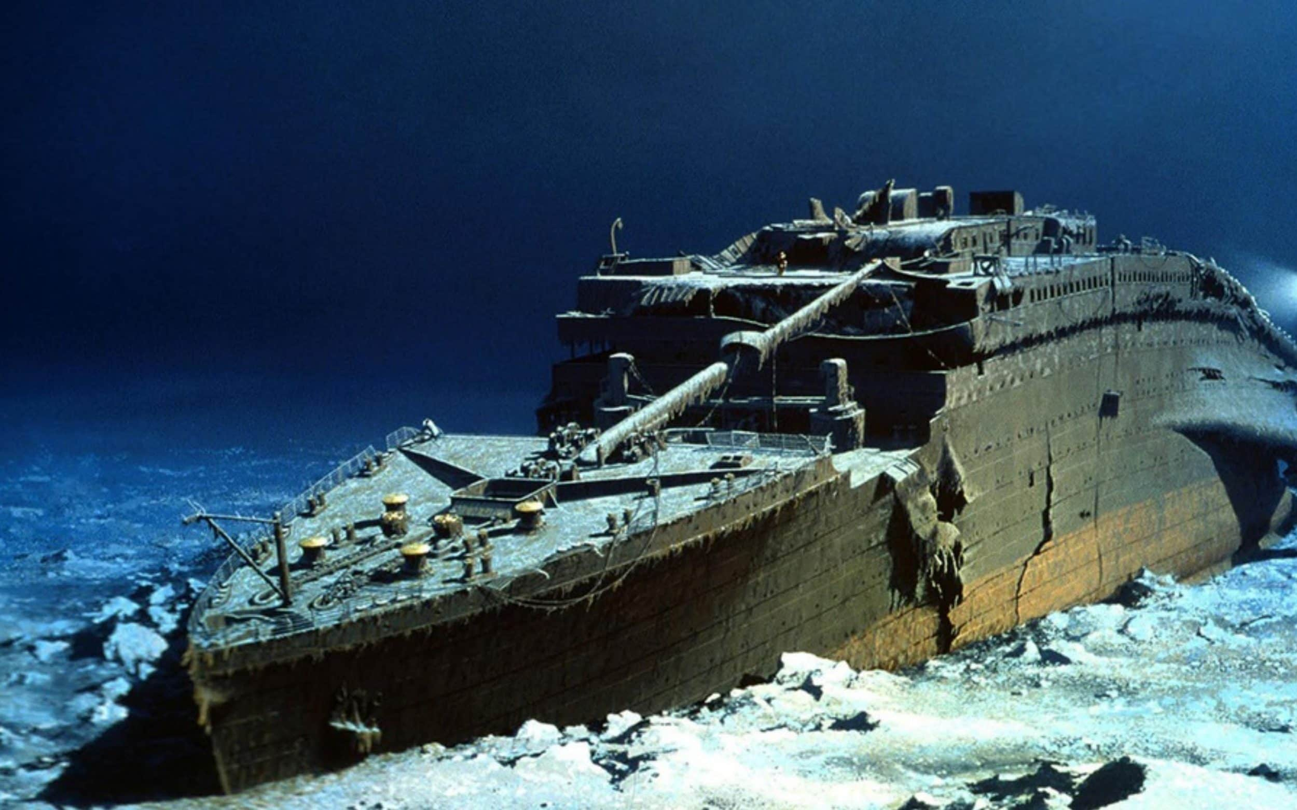
CONCLUSION
Suggestion
The accuracy potential of the machine learning model to be developed can be further enhanced beyond the outcomes achieved in this case study.
The LazyPredict library can be utilized to swiftly compare the accuracy performance of various machine learning models.
Alternative machine learning or deep learning models can be explored to identify the most suitable type for addressing the classification of casualty counts in the Titanic shipwreck.
Data Science Digital Skill Fair 30.0
by:

Slide 18
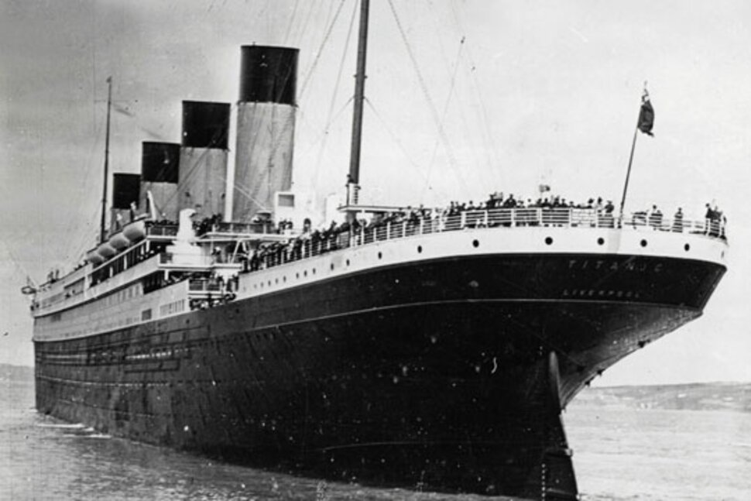

Thank You
If you have any insights, suggestions, or feedback, please do not hesitate to make a pull request or fork this repository, or you can contact me to discuss further.
Thank you for your attention, cheers.
https://www.linkedin.com/in/dionixius/
inikampus7@gmail.com
https://github.com/dionixius7/Titanic-disaster-ML-Model

